Slide 1

History of Video Games
By David Jentes

Slide 2
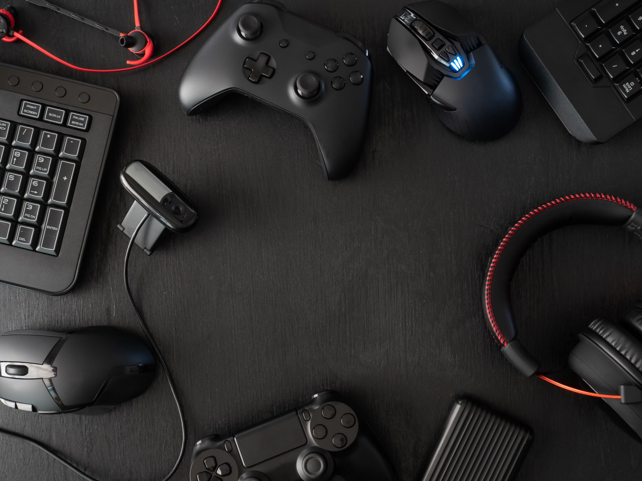
What is a video game?
Merriam-Webster
A video game is an electronic game in which player control images on a video screen.

Slide 3
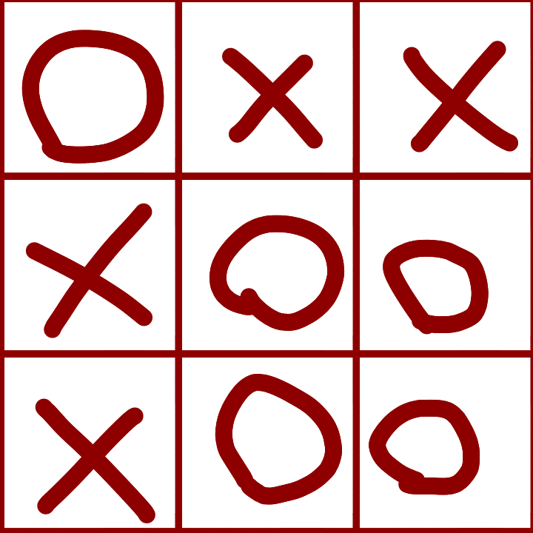
First video games
There are a few contenders for first video game, depending on your definition. The first game ever made for a computer that output text onto a screen was an adaptation of tic-tac-toe.

Slide 4
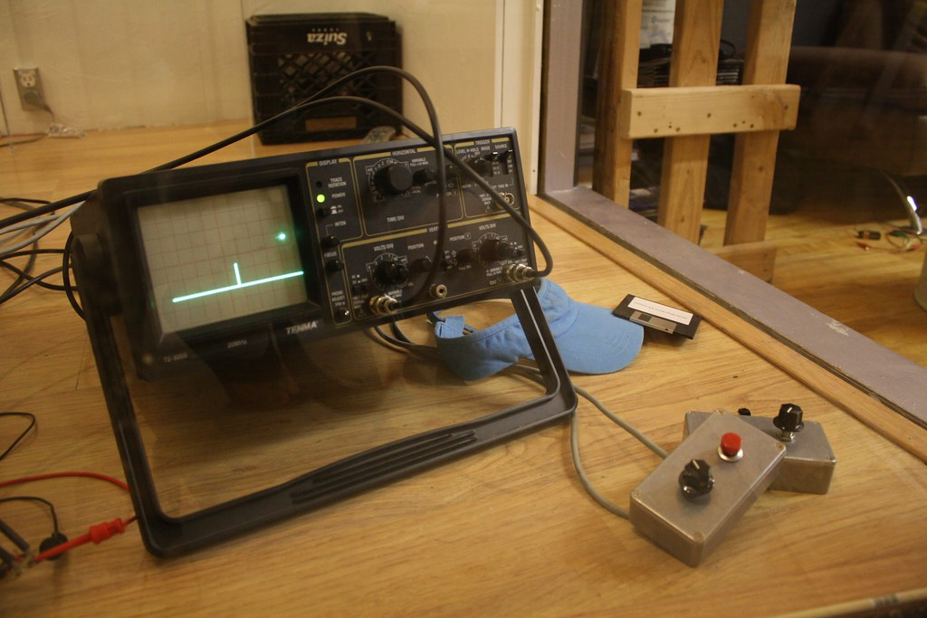
Many people think that video games should have more complex graphics than just text, specifically because text isn’t “video,” despite the fact that it is shown on a video display. In this case, the first game would be a game called Tennis for Two, which displayed on a screen by inputting voltages into an oscilloscope.
An oscilloscope showing Tennis for Two

Slide 5
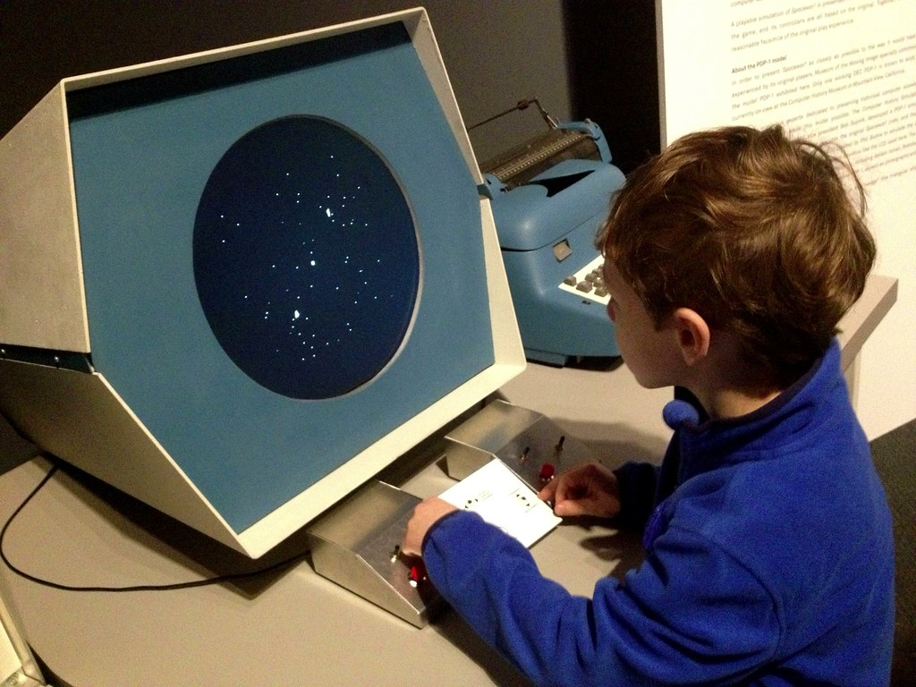
An oscilloscope is in fact a device to measure electric voltage, but, if you want to be even more picky, the first video game is Spacewar. Spacewar is the most famous video game of the three, after being made by MIT students to push the limits of computing. It was written for a DEC PDP-1 computer with a screen more like a television.
A DEC PDP-1 running Spacewar

Slide 6
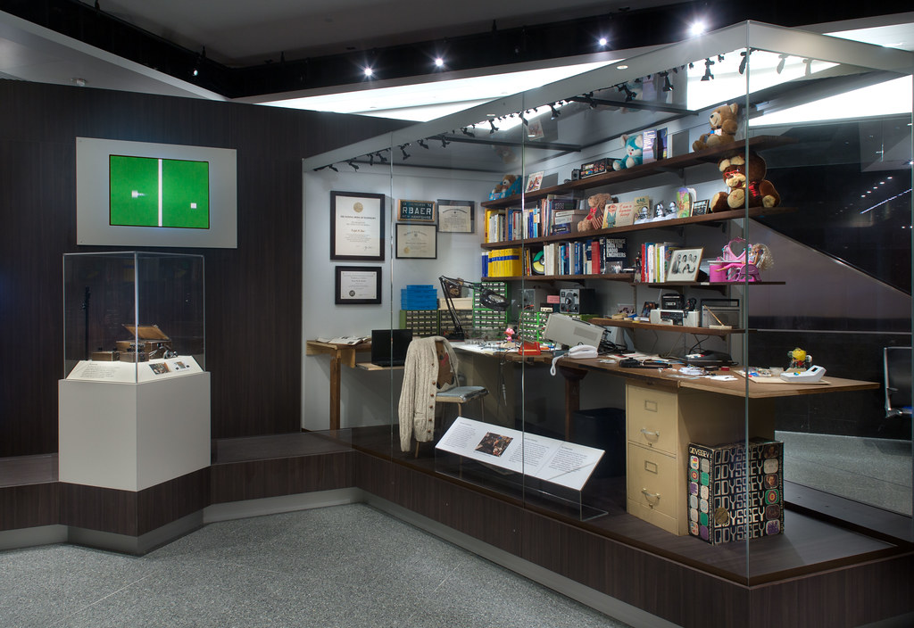
These early video games were made for machines at academic institutions to push the limits of what you could do with a computer. At this point, computers still took up quite a bit of space and did not have a place in the usual home. A man named Ralph Baer, however, had a different idea.
Ralph Baer’s workshop exhibit at the National Museum of American History

Slide 7
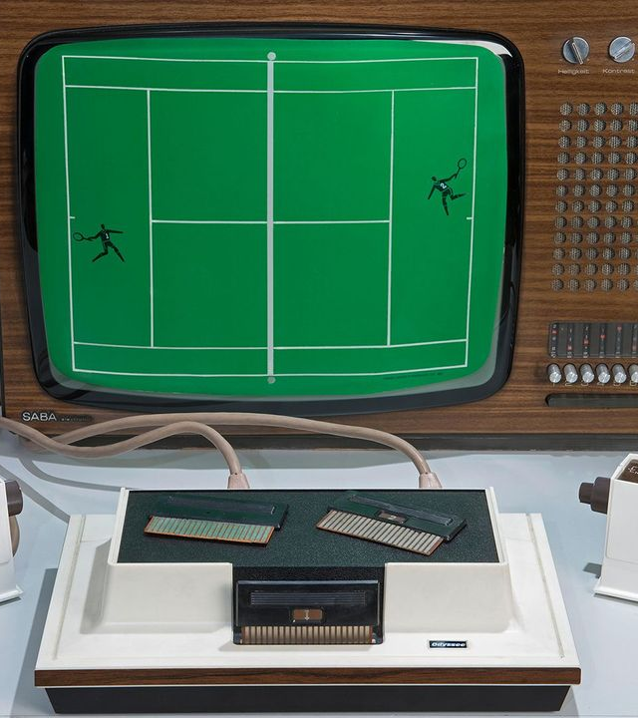
The first video game console
In the late 1960’s, Ralph Baer created a device that could produce a dot on a television screen. He worked on the idea further, until he eventually made a new prototype he nicknamed the “Brown Box.” The company he worked for and which owned the rights to the system licensed the technology to Magnavox, who released it as the Odyssey in 1972. A man named Nolan Bushnell saw a demonstration of this console, and had an idea.
An Odyssey playing Table Tennis

Slide 8
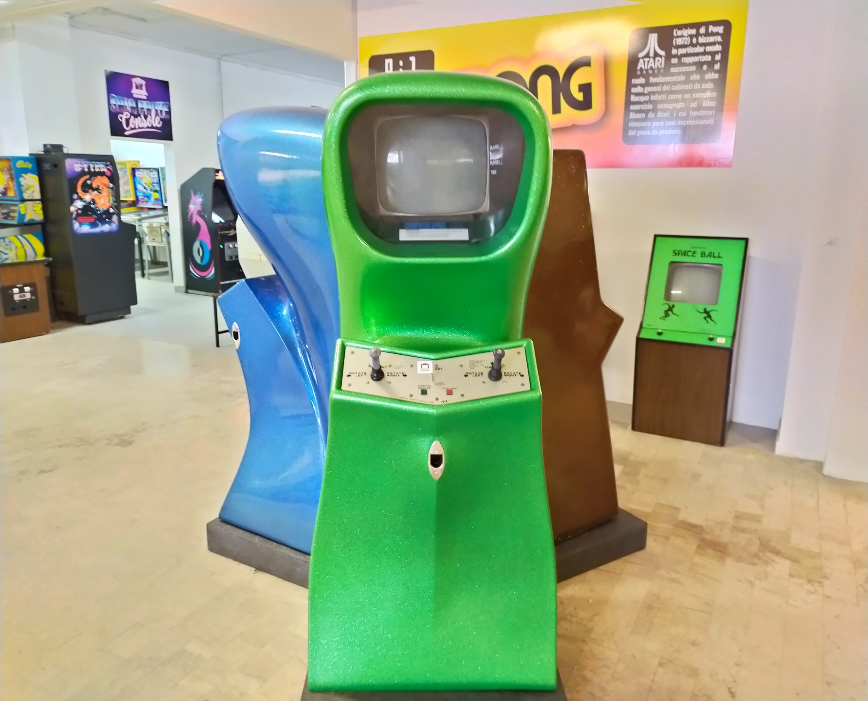
Into the arcade
He played the original Spacewar while he was a student at the University of Utah, and he decided to make a version of it for the arcade with his company Atari, making it one of the first video games to show up there. The problem is, Spacewar is a complicated game for most people to play, and Computer Space was even more complicated due to there only being one player instead of two.

Slide 9
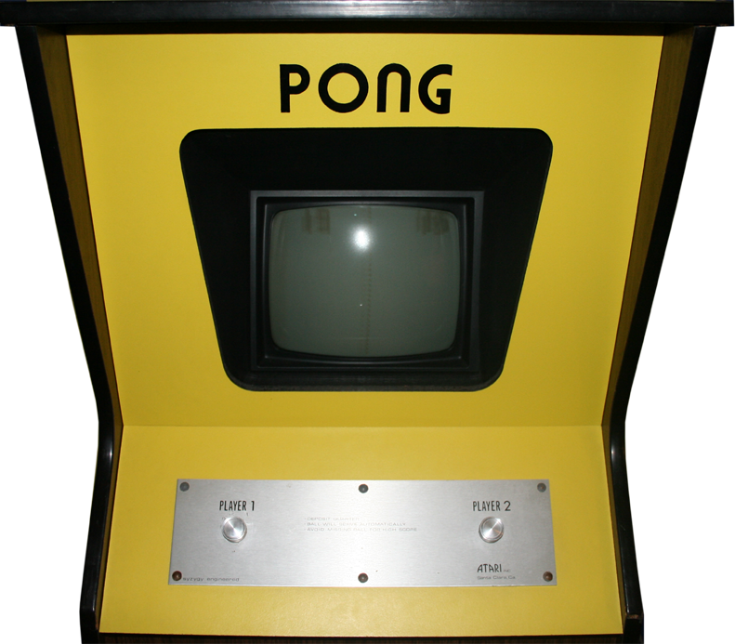
Pong
He saw the Odyssey being demonstrated, and founded a company named Atari with a business partner named Ted Dabney. They created “Pong,” a game like the table tennis game for the Odyssey. The first machine was placed, and it only lasted a few days before it needed serviced. When they went to look at it, there was only one issue: too many quarters were put into the machine! Atari quickly partnered with Sears, Roebuck, and Co. to produce a home version of the popular game and caught notice of Magnavox.
The main portion of a Pong arcade cabinet

Slide 10
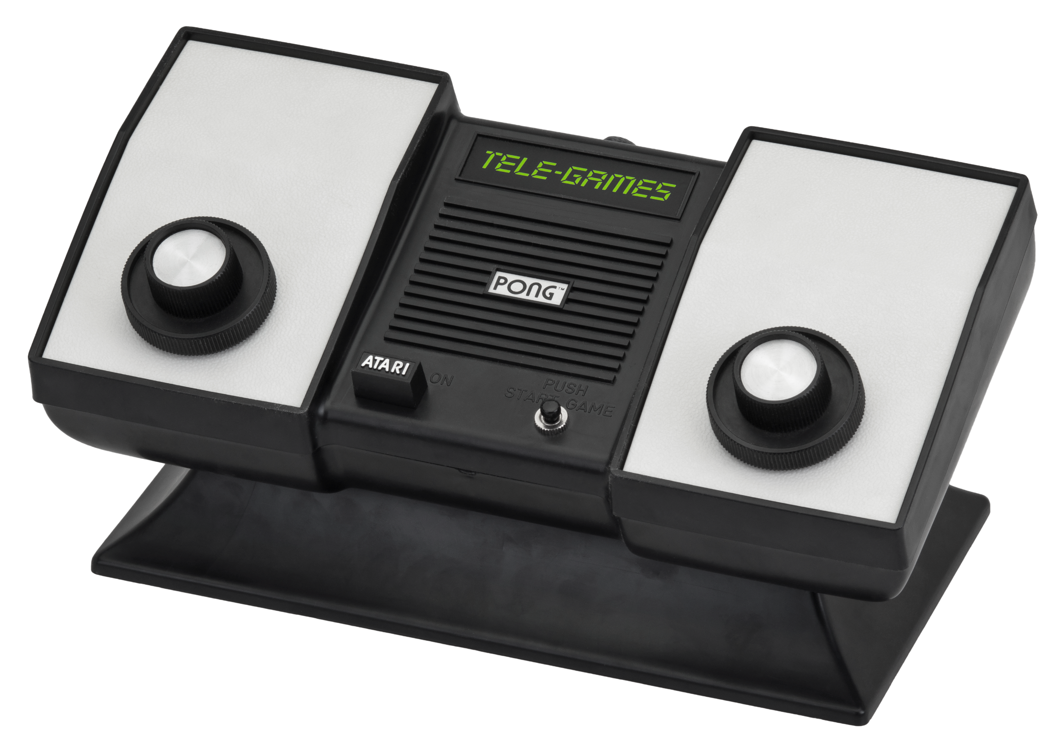
Trouble for Atari
They weren’t happy, since it was nearly an exact copy of their game! They sued Atari for patent rights infringement, proving that Bushnell saw it, and even played it! Atari ended up settling with Magnavox. They knew they couldn’t win, because of its extreme similarity! After this though, the entire market boomed for companies trying to earn money off of Atari’s fame.

Slide 11
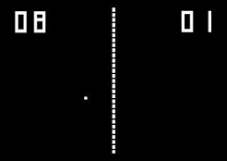
Pong in the home
After the Pong system by Atari and Sears, other companies wanted to join in. Magnavox was even joining in themselves, making modified Odysseys that could only play Table Tennis and a couple other games. This started the first generation of gaming consoles, with the most famous being made by Coleco, who also produced other popular toys in the 1980’s. Coleco had a trick up their sleeve to steal the whole market.

Slide 12
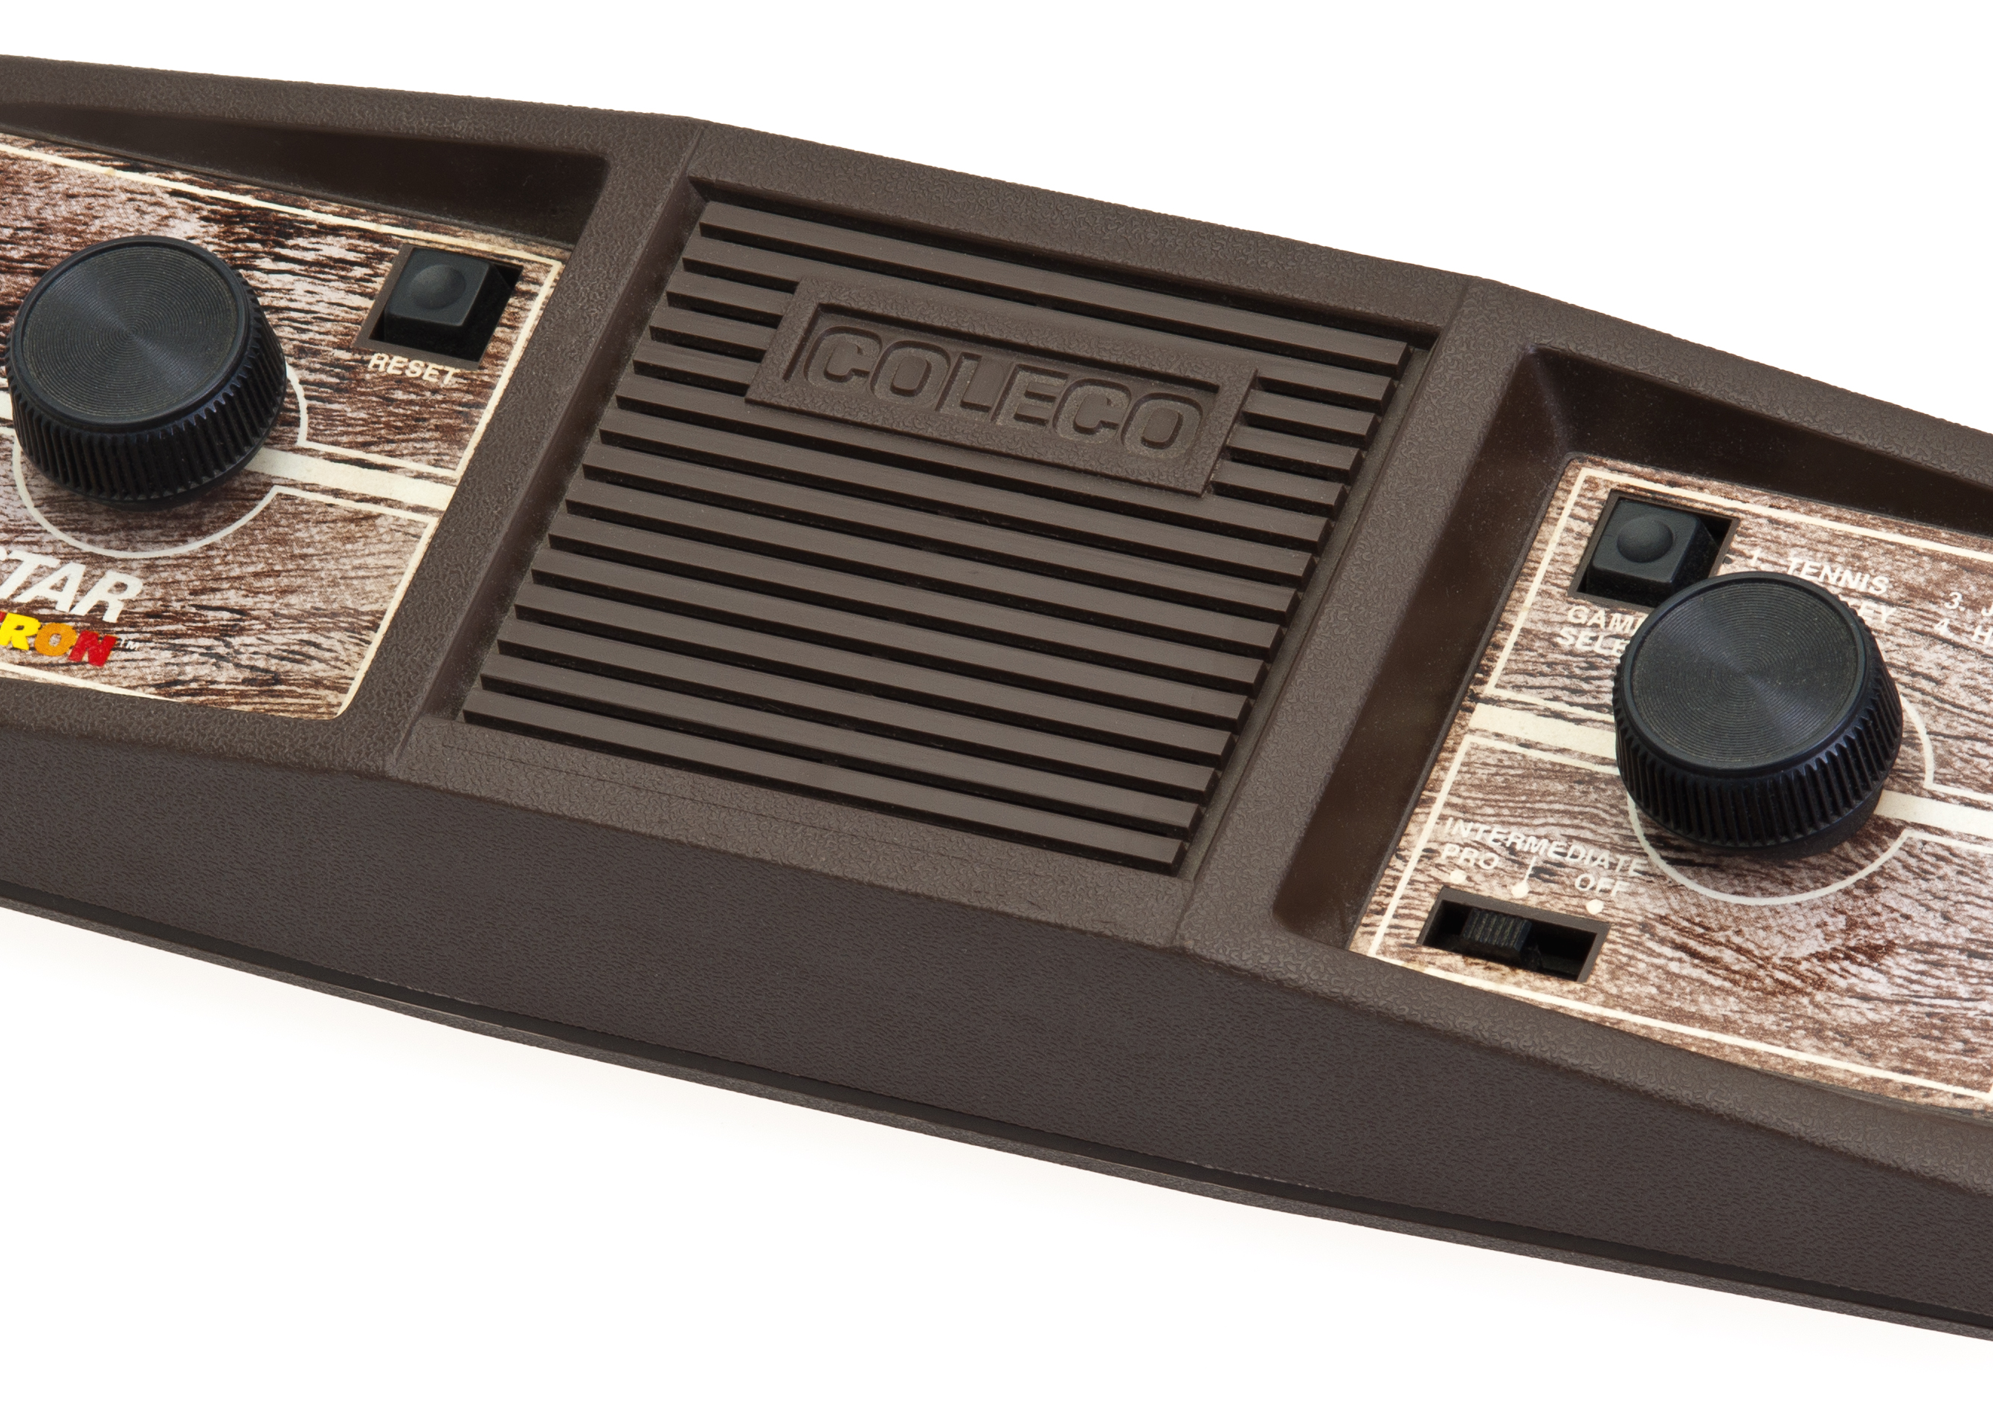
Coleco takes over
Coleco was trying their best to cement themselves as the best Pong console manufacturer and placed a large order for the chip used in most Pong consoles. General Instruments, creator of the chip, couldn’t keep up with the demand. Coleco, being their first big customer, was top priority. While other companies waited for their chips to arrive, Coleco cornered the market. Soon, video game consoles got more advanced.

Slide 13
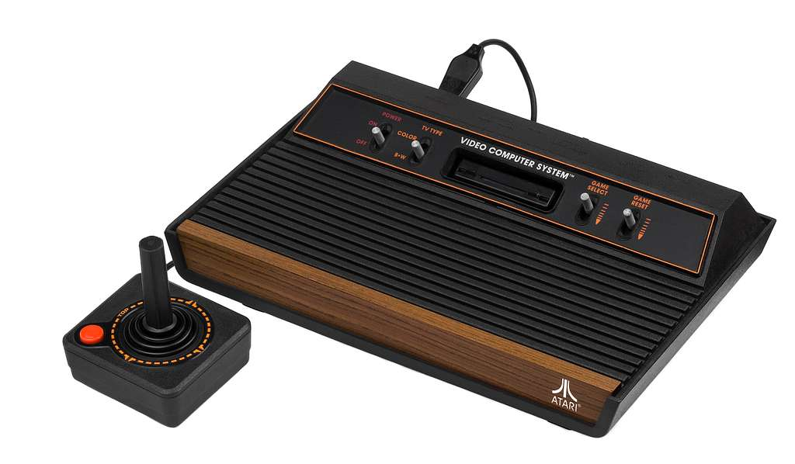
Second generation of consoles
The next generation of consoles had begun, going from simple Pong consoles to the Atari VCS, the Intellivision by Mattel, and the ColecoVision. These consoles had one advantage over the Odyssey. They introduced interchangeable cartridges with games stored on them instead of the consoles themselves. More games could be produced over time, and games started to flood the market from many manufacturers.
Atari VCS, also known as the 2600

Slide 14

Video game crash of 1983
As these games kept flowing in, quality of each game decreased greatly. One game, based on the movie E.T., was so bad that many copies famously ended up in trash dumps. Consoles and games weren’t selling, and Mattel and Magnavox discontinued their video game product lines. Atari struggled to stay afloat. Arcades seemed to be doing well, but some still suffered. Chuck E. Cheese’s Pizza Time Theater, created by Atari founder Nolan Bushnell, filed for bankruptcy in 1984. However, while the market in America was growing and later collapsing, other countries started to see an opportunity.

Slide 15

Japan enters the scene
A Japanese man named Fusajiro Yamauchi (房浩山内) began a small business manufacturing “Hanafuda” playing cards in Kyoto, Japan in 1889. His sons continued the company, going into many types of business ventures, trying to see what sticked. They started providing taxi services and manufacturing toys, and when they started making Pong consoles, they knew what they wanted to make.

Slide 16
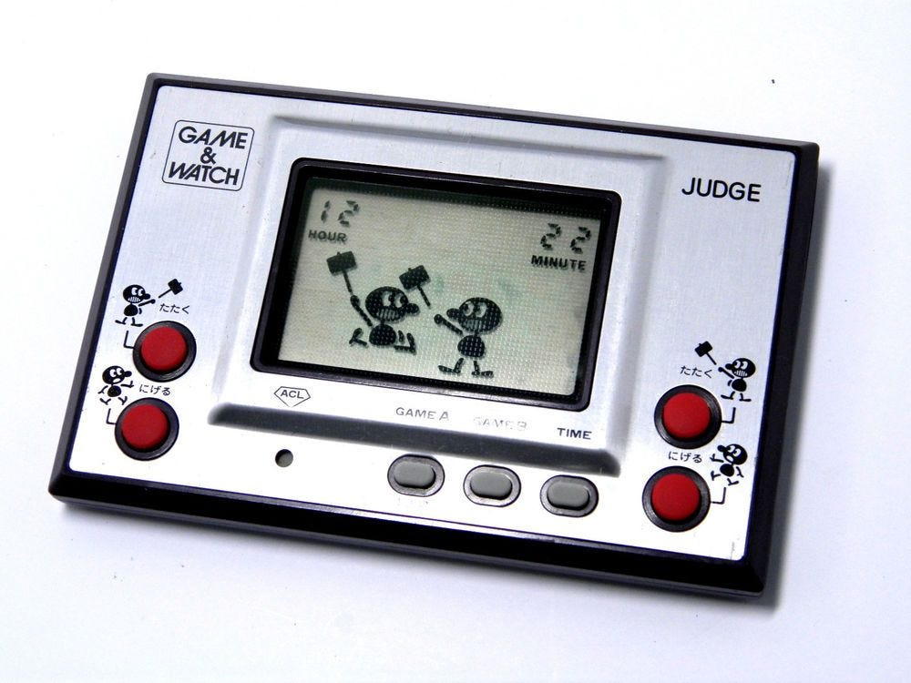
An innovative new device
A man named Gunpei Yokoi (グンペイ横井) was working for Nintendo, and when he was on a flight, he noticed a bored man playing with his calculator. This gave him the idea for the “Game & Watch.” Nintendo of America was founded in 1980 to sell the product. However, a man named Shigeru Miyamoto (茂る宮本) started a series that lasts even until today.

Slide 17
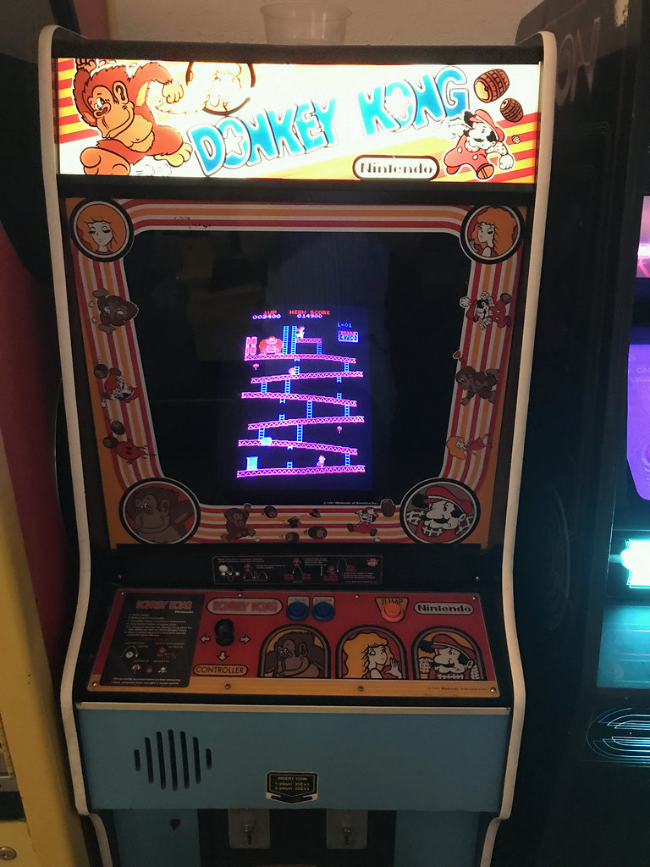
Mario’s beginnings
Miyamoto-san developed a game called Donkey Kong, which was so fun that it became the hottest-selling game in the arcade business. The game featured Jumpman, who raced against a crazy ape to save his girlfriend. Nintendo later nicknamed him “Mario” because he looked quite similar to the landlord of the American office of the company, Mario Segali. Nintendo knew they could take over the home market with this popular game.

Slide 18
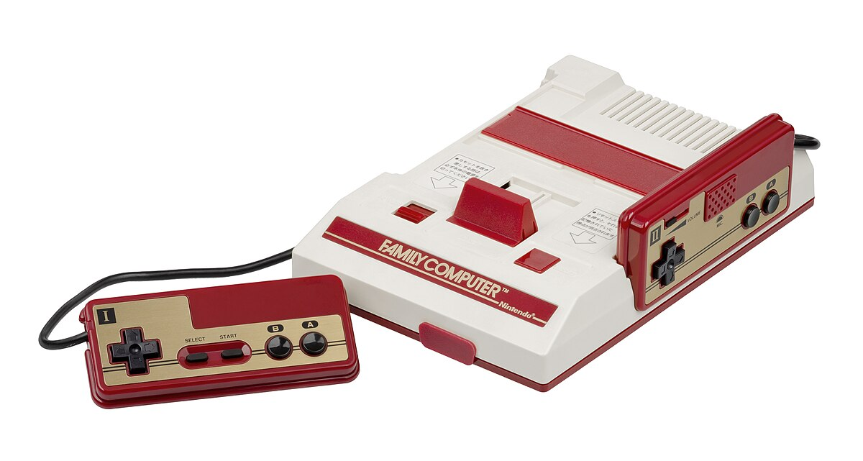
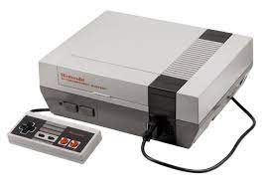
Third generation of consoles
In 1983, they developed a console called the “Family Computer.” It was named this way because of the crash in America at the time. It was so advanced it started a new generation, with it being the only major competitor, especially in America. They created a new game especially for the system called “Super Mario Bros.,” based on the Mario character from Donkey Kong and his brother Luigi. They released the console in the United States in 1985 as the “Nintendo Entertainment System,” still trying to separate it from the older consoles that caused the crash. They also had preventative measures to prevent it from happening again.
Famicom, Japanese model
NES, American model

Slide 19
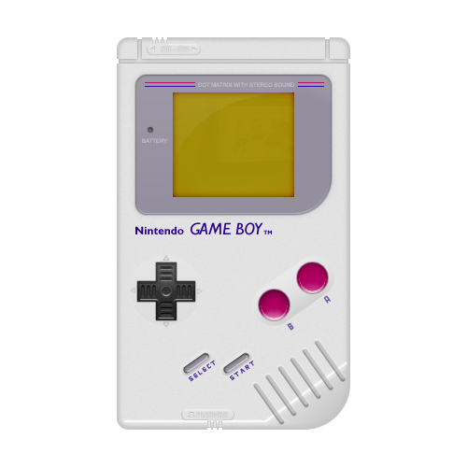
Handheld gaming
The NES was a powerhouse for the time, but people didn’t want to be stuck on the TV to play. Nintendo came up with a great idea, which was merging the portability of a Game & Watch and the cartridges of the NES to create a new console called the Game Boy. Nintendo didn’t want to limit sales to “little boys” by including Mario with the console, so they originally sold the console with a copy of the Russian puzzle game Tetris. Many popular NES games were adapted to the Game Boy, and the successful Pokémon games started on the console.
The original Game Boy model DMG-01

Slide 20
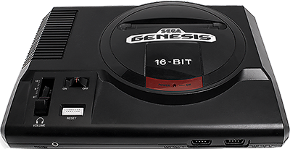
First “console war”
After the NES, the Super Nintendo Entertainment System came out. This time, a company named Sega had caught on with their Genesis console. This started the first “console war,” which happen each generation to this day. Nintendo had the recognizable characters, but Sega had superior hardware. Sega eventually had a character who caught on, being Sonic the Hedgehog, but not until the end of the console’s lifespan was coming. Sega’s consoles were popular with certain game companies because they weren’t opposed to violence.

Slide 21
Violence in video games
Video game violence at home started with the game “Mortal Kombat” for the Genesis. The game featured fighting, blood, and gore, which started to alert parents of the time to the fact that there was no rating system for games. There are film ratings and TV ratings, but there was not yet such a thing for games. Parents had no idea whether a game they purchased would be appropriate, with many game series that previously not having violence adding it into new games. The Interactive Digital Software Association saw this need, and decided to design a rating system.

Slide 22
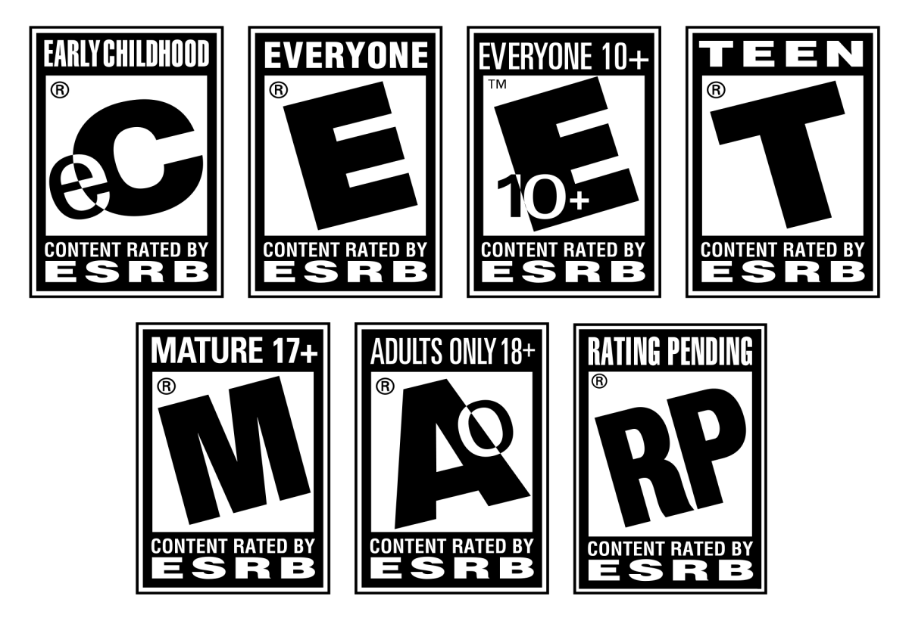
ESRB
They founded the Entertainment Software Rating Board in 1994, and started to categorize many games into one of five rating categories, “Early Childhood,” “Kids to Adults,” “Teen,” “Mature,” and “Adults Only.” Each rating has a symbol based on the letters in the name. In 1998 the K-A rating was changed to the E rating, for “Everyone,” to make it more clear to consumers. They also launched celebrity PSAs about the ratings to get the word out to parents. In 2005, they added the Everyone 10+ rating to make it even clearer. Other rating systems were used in other countries. Game cases as well as online marketplaces show the respective rating for your country if the game is rated. Games cannot be released on consoles if they are not rated or “Adults Only.”

Slide 23
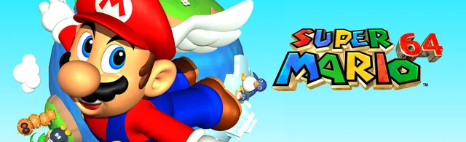
3D games
Games became more and more complex as new hardware released. Some games for the SNES had an add-on chip called the Super FX, adding rudimentary 3D capabilities to their console. Nintendo worked on a CD drive with Sony but ended up abandoning the project due to disagreements. Sony did not give up though, working hard and getting a console called the PlayStation, which was going to be the name of the CD drive, in 1995. Nintendo worked with a 3D hardware company called SiliconGraphics to create the Nintendo 64, their next generation console, which released in 1996. The first game for the console was Super Mario 64, which set the standard for how 3D games are controlled, even to this day.

Slide 24
Many new games came out, some in recognizable series, and others being brand new. Newer developers tended to go to Sony’s platform, while Nintendo still had the recognizable characters. Sega and Atari were still releasing less popular consoles but weren’t doing so well. At the end of the generation, they stopped making consoles and both started selling their games on the other consoles. Sony and Nintendo both released their new consoles in the early 2000’s, called the PlayStation 2 and GameCube respectively. Microsoft, however, had something cooking up behind the scenes.

Slide 25
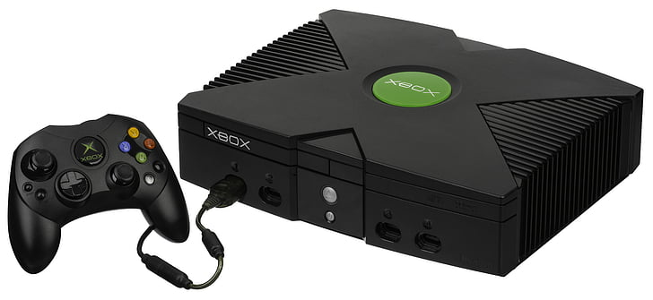
The Xbox
The popular operating system and software maker had already worked on Sega’s last console, but was now creating their own console called the “DirectX-Box,” later shortened to Xbox. After fighting with management to release it, it was released in 2001 to great acclaim. Sega decided to release many games originally intended for their last console on Microsoft’s platform due to the partnership they had before. Technology was still developing, and a revolution in TV
and video games was about to begin.

Slide 26

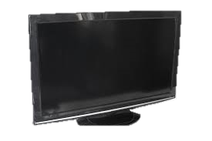
High-definition
Sony and Microsoft introduced the PlayStation 3 and Xbox 360 respectively, and these consoles had new connectors on them to support newer TVs. These newer TVs were no longer powered by cathode ray tubes, but instead a grid of pixels. These pixels could be packed together so much that much higher definition images could be created. These consoles took advantage of that, and both had support in some capacity for an alternative format to DVD that could support the form factor, Sony supporting Blu-ray, and Microsoft supporting HDDVD with an external drive. Blu-ray ended up winning in media, but the Xbox 360 won due to the much cheaper price needed for the PS3’s very advanced hardware and Blu-ray drive.

Slide 27
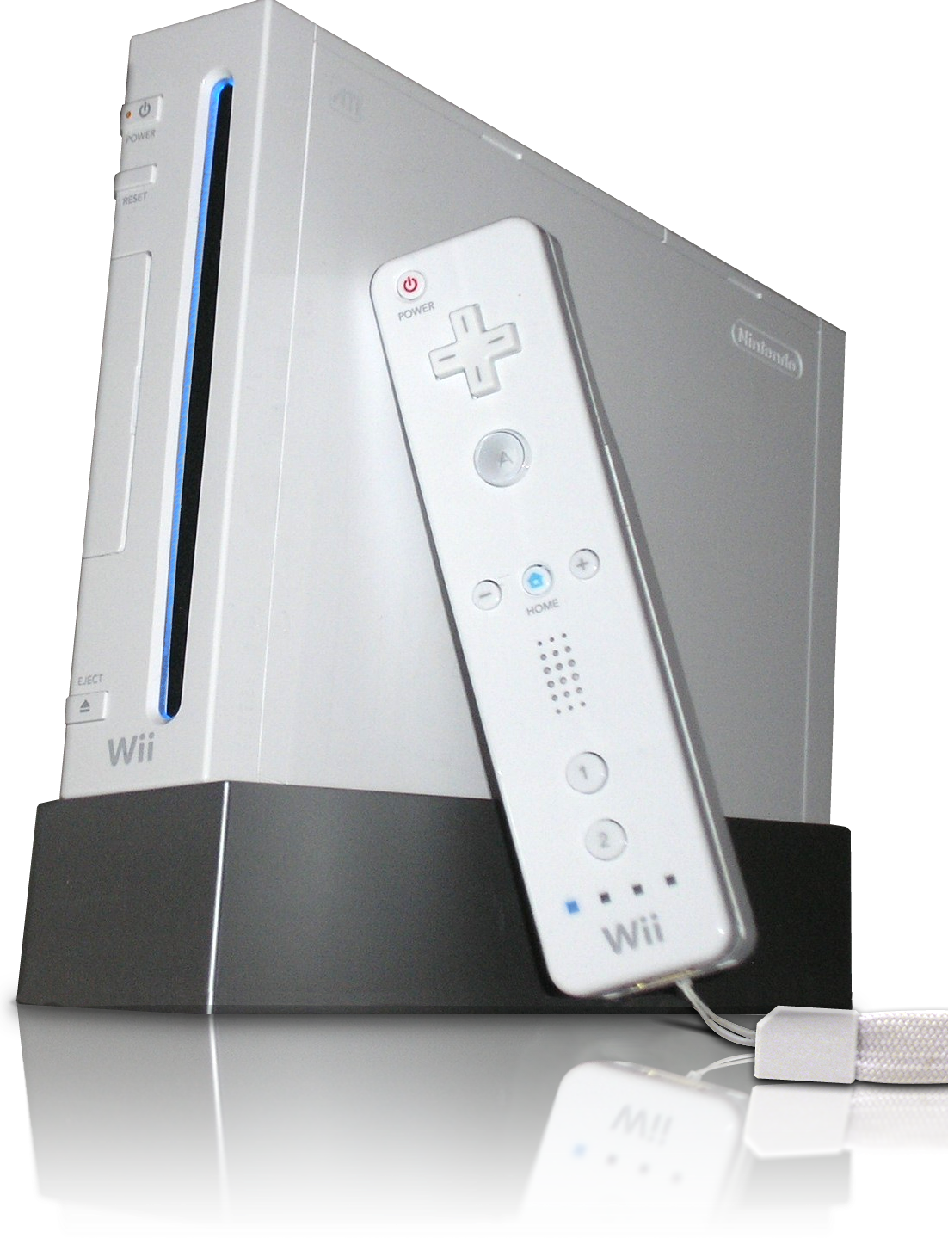
The Wii
Nintendo, however, had a different idea. Instead of making a new more technically advanced console, they ended up making a more affordable option. The controllers that have been used to interact with games since the NES were thrown out the window, and Nintendo found an alternative that would wow families across the world. They released the Wii in 2006, and it quickly became the best-selling console of all time. Many families played the game included at the time, Wii Sports. The game contained modes for bowling, golf, baseball, tennis, and boxing, as well as training and fitness.

Slide 28
The next generation
Nintendo followed the Wii with the Wii U, which was confused as an accessory for the original Wii instead of a new console. This console had high-definition graphics like the competition last generation. Microsoft introduced the Xbox One, which had backlash for requiring you to have a motion-sensing camera plugged in to use it, threatening privacy. It also required an internet connection and had a laughable policy on making used games impossible with the console. All three of these decisions were changed before the console came out, but it never recovered. Sony’s PS4 improved on the last generation, and ended up winning due to the backlash of the Xbox.

Slide 29
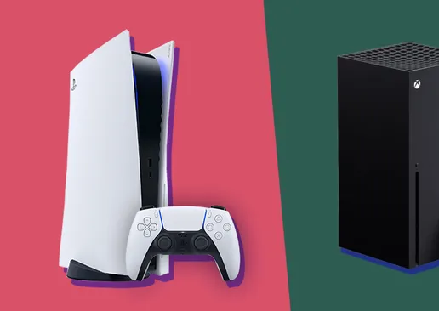
4K graphics
Consoles were improved to have even more impressive graphics with a mid-generation upgrade in the form of the Xbox One X and the PS4 Pro. Nintendo, however, discontinued the Wii U and decided to start over. Nintendo didn’t support 4K with their new console, but instead made a handheld that could connect to a TV and had removeable controllers. The Nintendo Switch released in 2017, and was the only console of the nineth generation until the Xbox Series S and X and the PS5 launched in 2020. These improved even further on the previous generation, and the market is currently leaning towards Sony due to better games that are only playable on their console.

Slide 30


Video games in ministry
Video games can be used to lead others to Christ in a few different ways. The main way to do it is to make videos or livestreams about playing video games where you also discuss Christianity and how to become a Christian. If people enjoy your content enough, they will seriously consider it. One such YouTuber is Redeemed Zoomer with his “KingdomCraft” series, where he builds a church, or more recently a university, in Minecraft while discussing many core theological components of Christianity. I personally enjoy his videos even though he is of a different Christian tradition than I am.
There is also a game studio named Bible X. They are making a game called Gate Zero which aims to allow you to “play the Bible.” You can play a video game where your character goes through many popular Bible stories, including the life of Christ, while travelling back in time. If a Christian influencer on the internet plays it, even if their fans don’t already recognize them as a Christian, then they will have the opportunity to show people what happened in the Bible and encourage them to read it themselves.

Slide 31
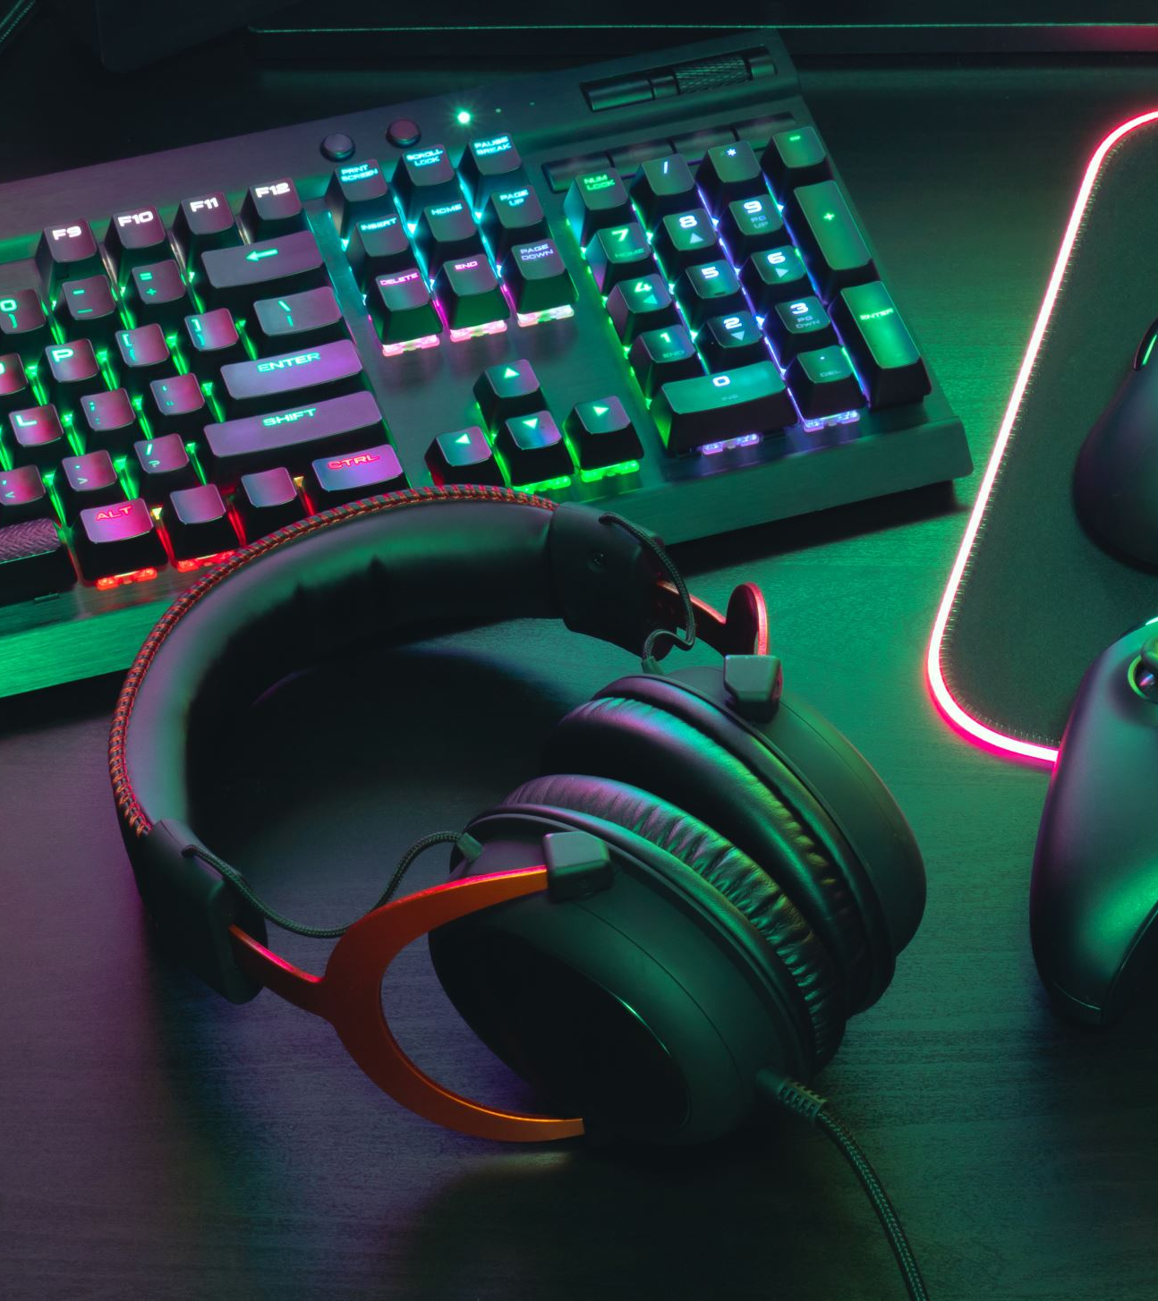
Summary
Video games were created to test the limits of what computers could do. Companies then created machines for arcades to make more money. Then, consoles were the most popular toys, and not thought of as anything more. The Wii revolutionized that and introduced them to the whole family. Now, the industry aims towards people who play video games for entertainment during their free time, whether adults or children, with games being aimed for one or the other, or often both with family-friendly games. On top of that, people have started to use them for ministry. Video game history is very interesting for me, and I hope you enjoyed reading about it.

